Slide 1
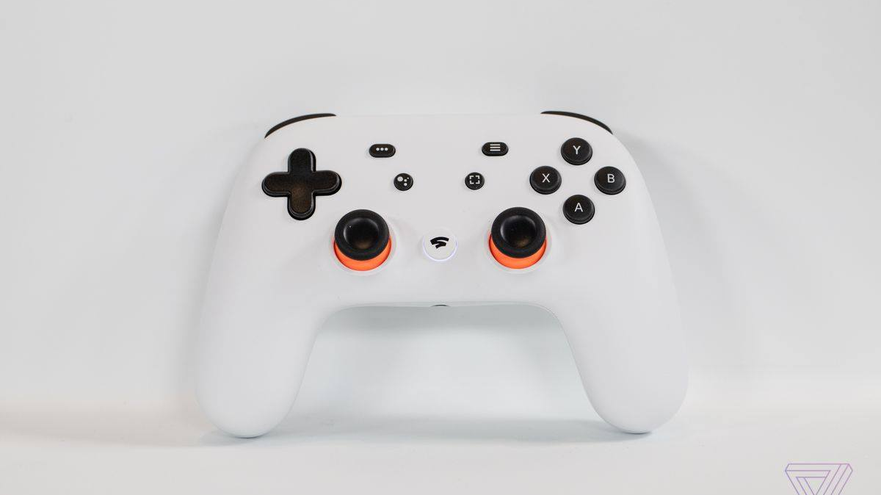
Stadia Strategies
Inspector Graduates

Slide 2
Stadia can increase Google revenue by 2% in 6 years
Overview
Cloud gaming
Cloud gaming is an 1 Bn industry that’s projected to grow to 5 Bn in 6 years [1]
Google
Google is uniquely positioned to capture this market
Establish brand
Short-term rec: Establish a brand with marketing campaign
Enter APAC
Middle-term rec: Enter APAC gaming market to increase userbase
Focus on mobile and VR
Long-term rec: Create next-gen gaming with mobile+5G and Virtual Reality

Slide 3
Cloud gaming market is expected to hit $5Bn in 6 years
Cloud gaming
Google
Establish brand
Enter APAC
Next-gen Gaming
USD (Billions)
marketwatch.com/press-release/cloud-gaming-market-expected-to-grow-at-cagr-2445-and-forecast-to-2025-2019-07-01

Slide 4

Stadia enthuses 37% of non-gamers and 31% of gamers¹
Cloud gaming
Google
Establish brand
Enter APAC
Next-gen Gaming
“I don’t want to buy a console, PC, or GPU but I’d subscribe to Stadia.”
“I’d buy Stadia if it allowed me to play something I never could before.”
Non-gamer
Gamer
1. Study conducted by Inspector Graduates on 33 U.S. Millenials

Slide 5
Google is positioned to capitalize given its strengths
Cloud gaming
Google
Establish brand
Enter APAC
Next-gen Gaming
Company | Gaming brand | Server presence | Mobile platform | Next-gen gaming
Google
Microsoft + Sony
Nvidia, Shadow, Antstream, etc.

Slide 6
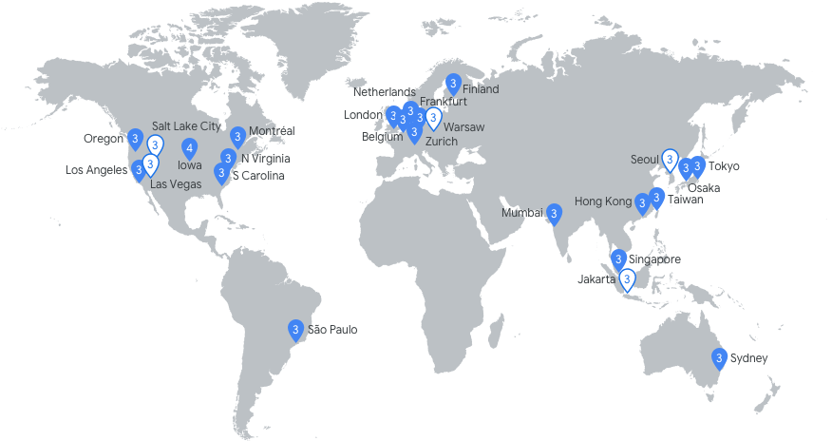
Google is positioned to capitalize given its strengths
Cloud gaming
Google
Establish brand
Enter APAC
Next-gen Gaming
Company | Gaming brand | Server presence | Mobile platform | Next-gen gaming
Google
Microsoft + Sony
Nvidia, Shadow, Antstream, etc.
134 Points of Presence [2]
Notes:
if independent game developers what to create/stream games, want to create the platform for that. We need them to use Google and not Amazon and Microsoft. Making the barrier of entry very lost -- say 14.5

Slide 7



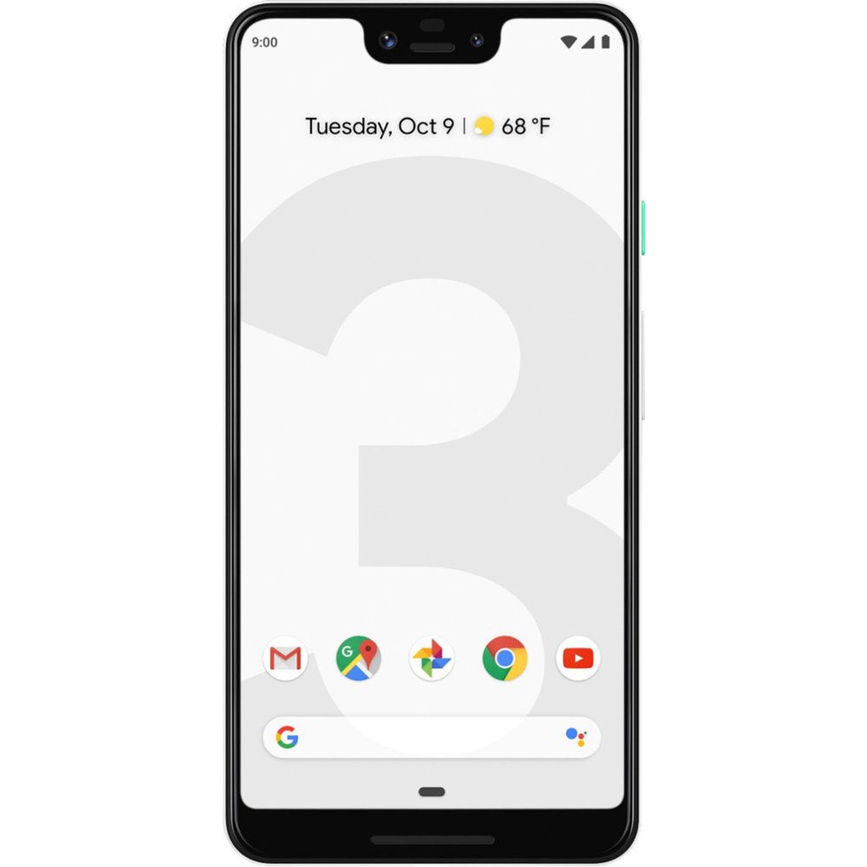
Google is positioned to capitalize given its strengths
Cloud gaming
Google
Establish brand
Enter APAC
Next-gen Gaming
Keyword | Gaming brand | Server presence | Mobile platform | Next-gen gaming
Google
Microsoft + Sony
Nvidia, Shadow, Antstream, etc.

Slide 8
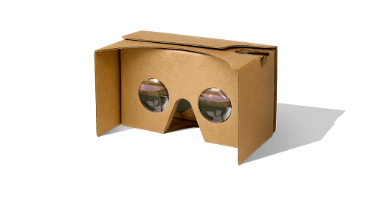
Google is positioned to capitalize given its strengths
Cloud gaming
Google
Establish brand
Enter APAC
Next-gen Gaming
Keyword | Gaming brand | Server presence | Mobile platform | Next-gen gaming
Google
Microsoft + Sony
Nvidia, Shadow, Antstream, etc.

Slide 9
Google can capture $1.9Bn profit in 6 years by following a strategy with three horizons
2019
2021
2023
$750M
+$680M
+$480M
Establish a brand
Target non-gamers and influencers in aggressive marketing campaign
Enter APAC gaming market
Enter largest and fastest growing geographic gaming market
Offer next-gen gaming
Provide novel gaming experiences with streaming mobile and VR

Slide 10
Tailor marketing to non-gamers and influencers
Cloud gaming
Google
Establish brand
Enter APAC
Next-gen Gaming
-$88M
Ad campaign for non-gamers
Non-gamers are 20% more likely to convert to Stadia than gamers¹
Promotional subscriptions to influencers
YouTube influencers will 1) increase YouTube revenues and 2) market to gamers
-$1M
Marketing

Slide 11
Stadia is projected to cost $450M in the first year
Cloud gaming
Google
Establish brand
Enter APAC
Next-gen Gaming
5M
Computing resources
Includes fixed server costs and variable computing costs for energy and server maintenance
89M
52%
Streaming
Google’s datacenter coverage allows streaming at 3c per hour
27%
Costs
Marketing
Includes ad campaigns for non-gamers and promotions for 5000 YouTube influencers
20%
120M
230M
Research and development
Provides yearly budget for 25 engineers and researchers
1%

Slide 12
Offset costs with $1.2Bn revenue from three streams
Cloud gaming
Google
Establish brand
Enter APAC
Next-gen Gaming
$131M
Subscriptions
$10 per subscriber per month
65%
Game royalties
30% royalty collected per game sold
24%
$288M
Revenue
YouTube Ads
6c per ad view
11%
$770M
Google Fi
No revenue before Stadia can use cellular networks
0%

Slide 13
APAC estimated to introduce 14M Stadia users
Cloud gaming
Google
Establish brand
Enter APAC
Next-gen Gaming
NAM + W-EU Existing Users
Total gaming population of 406M, 38% share of global revenue, +7 YoY growth [3]
42%
Users
New APAC users
Total gaming population of 1.2Bn, 51.8% share of global revenue, +16.8% YoY growth [3]. Further, larger fractions of the population have access to fast WiFi.
58%
10M
14M
!
Google is unlikely to rollout datacenters in China by 2021

Slide 14
Entering APAC increases yearly profits by $700M
Cloud gaming
Google
Establish brand
Enter APAC
Next-gen Gaming
+1.4B
Rollout Stadia in Japan, Korea, Taiwan
Enter largest and fastest growing geographic sector by using Google’s existing datacenters in Asia
-$700M
Introduce Asian marketing campaign
Promote Stadia APAC with marketing campaign 1.5X larger than in the US for $110M
!
Google is unlikely to rollout datacenters in China by 2021

Slide 15


Next-gen gaming brings 5.6 users and +$460M in profit
Cloud gaming
Google
Establish brand
Enter APAC
Next-gen Gaming
Provide low barrier of entry to VR
Dev Mobile & VR games w/out compute constraints
Offer Stadia-on-Cellular with 5G
!
Streaming VR is technically challenging
!
Rollout of 5G has opportunities and risks
5.6M
users

Slide 16
Summary: Increase Google’s total revenue by 2% in 6 years with 3-pronged Stadia strategy
2019
2021
2023
$750M
+$680M
+$480M
Establish a brand
Target non-gamers and influencers in aggressive marketing campaign
Enter APAC gaming market
Enter largest and fastest growing geographic gaming market [3]
Offer next-gen gaming
Provide novel gaming experiences with streaming mobile and VR

Slide 17



Inspector Graduates
www.inspectorgraduates.com
Angela H. Jiang
Husni Almoubayyed
Maitri Vasa
5th Year CMU CSD PhD
4th year CMU Physics PhD
Information Systems Grad Student
E: ahjiang@cs.cmu.edu
E: husnial@cmu.edu
E: mvasa@andrew.cmu.edu
www.angelahjiang.com
www.husni.space
T: +408 429 9599

Slide 18
YEAR 1 FINANCIALS
Userbase (M) | 9.6
Total Rev (M) | 1187 | Total Cost (M) | 443
Stream | Revenue (M) | Source | Cost (M)
Subscriptions | 768 | Marketing | 89
Game royalties | 288 | Streaming | 120
YouTube Ads | 131 | R&D | 5
Google Fi | 0 | Computing (fixed) | 229
 |  | Computing (variable) | 1.5

Slide 19
YEAR 1 Assumptions
YouTube captures 25% of Twitch streams [7]
YouTube watchers watch 20 ads per day
2/3rds of Stadia users pay for a subscription
Streaming costs 3c per hour
$500 per server [6]
1c of maintenance per hour per server
Stadia needs 20% of Nintendo’s Google marketing [5]
Market to 5000 influencers with $100 founders pack and 1 year’s subscription

Slide 20
APAC Financials
Additional users (M) | 14
Additional cost (M) | 714
Additional Profit (M) | 677
Assumptions: 15% of APAC users in Japan, South Korea, and
Taiwan and 10% convert to Stadia

Slide 21
Next-gen financials
Additional users (M) | 5.6
Additional cost (M) | 296
Additional Profit (M) | 459
Assumptions: Users are 26% more likely to convert with Stadia-VR

Slide 22
GoogleFi financials
GoogleFi Revenue | 20.8M
Assumptions: Users play an addition of 4 hours of Stadia at 50c/hour
Profit margin of GoogleFi is 20%

Slide 23
5G brings opportunity for GoogleFi revenue stream
Cloud gaming
Google
Establish brand
Enter APAC
Next-gen Gaming
Offer Stadia-on-Cellular with 5G
Tailor GoogleFi plans for Stadia-on-Cellular
Promotes both Stadia and GoogleFi
!
Streaming mobile popularity is constrained by rollout of 5G networks
+$20M
Streaming VR
Low barrier of entry to VR
Next-gen VR games aren’t compute constrained
Continue VRAds and VR game development
Risk:

Slide 24
References
[1] marketwatch.com/press-release/cloud-gaming-market-expected-to-grow-at-cagr-2445-and-forecast-to-2025-2019-07-01
[2] cloud.withgoogle.com/infrastructure/explore/step-1
[3] cdn2.hubspot.net/hubfs/700740/Reports/Newzoo_2018_Global_Games_Market_Report_Light.pdf
[4] developers.googleblog.com/2017/06/experimenting-with-vr-ad-formats-at.html
[5] statista.com/statistics/708011/nintendo-advertising-expenses
[6] techradar.com/news/amd-graphics-cards
[7] techcrunch.com/2019/07/12/twitch-continues-to-dominate-live-streaming-with-its-second-biggest-quarter-to-date/

